Slide 1
ENERGY, WATER, & EROSION

Slide 2
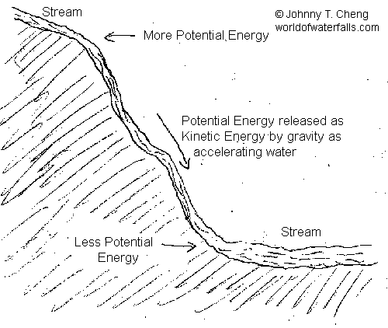
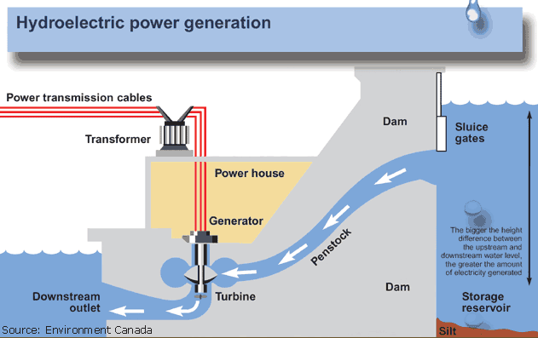
Energy (potential & kinetic)
This has huge implications for water management because of hydro power.

Slide 3
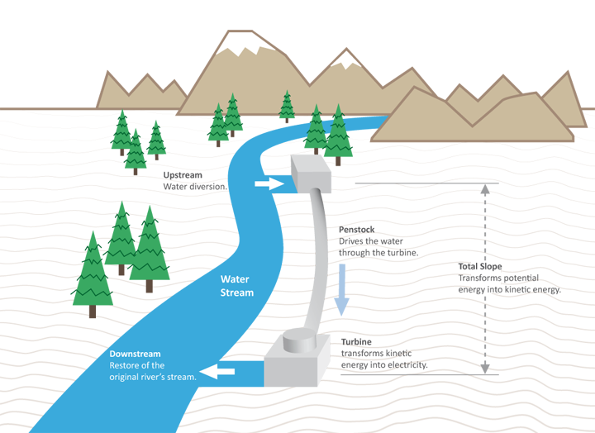
Run of river hydro
The dream is to move from traditional ‘dams’ to ‘run-of-river hydro.
What might be an implication of this transition?

Slide 4
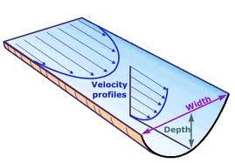
Stream Velocity
Where is the river flowing fastest?

Slide 5
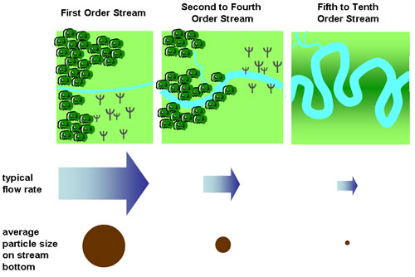
Erosion
Faster flow = larger particle transfer

Slide 6
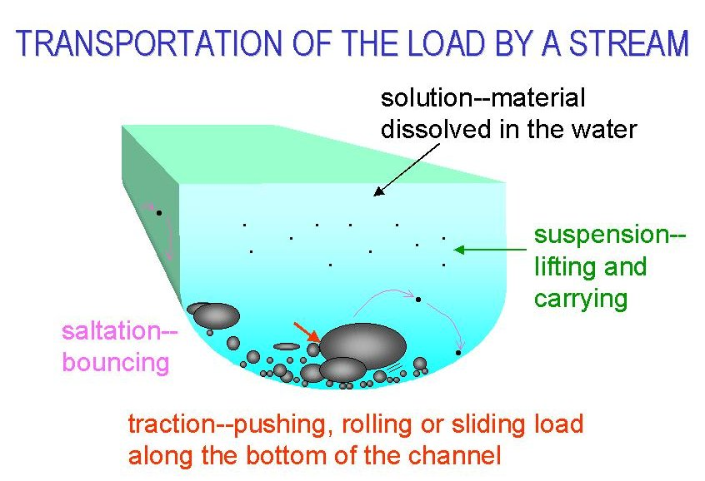
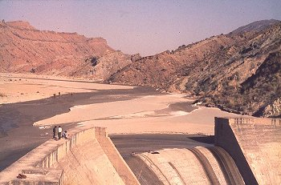
Sediment Transport
What are the implications for river damming and reservoirs?

Slide 7
Geog 10001: The Geography of Scarcity IWRM
Dr. Brian Cook
School of Geography
brian.cook@unimelb.edu.au

Slide 8
Today we will cover…
Water
Integrated Water Resource Management
Water Recycling

Slide 9
Today Visually
Production
Entitlements
Political (commission & omission)
Water Scarcity
IWRM
Water Wars

Slide 10
REVIEW OF LAST CLASS

Slide 11
Review of previous classes
How can we talk about management if we don’t understand the physical system that delivers water?
When we debate the need for desalinization plants, inter-basin water transfers, taxes on bottled water, or the need for international agreements based on water sharing or withdrawal from aquifers, we need a basic understanding of the physical science.
Please ensure you are confident with the Hydro-Cycle.
What is socio-material and what do I mean by it?

Slide 12
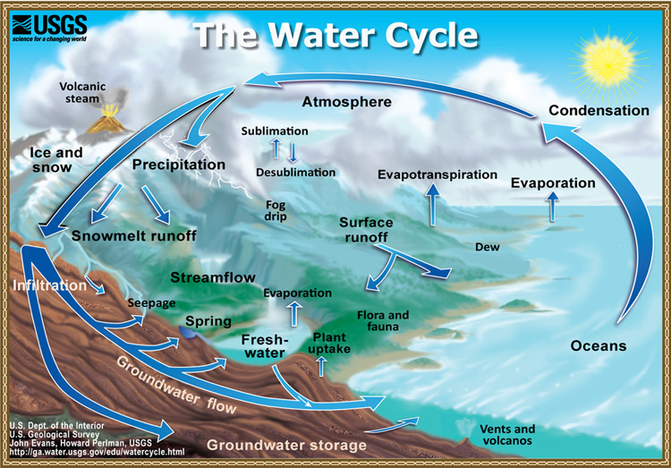
Water Cycle

Slide 13
Hydrosocial
“The hydrosocial cycle is based on the concept of the hydrologic cycle, but modifies it in important ways. While the hydrologic cycle has the effect of separating water from its social context, the hydrosocial cycle deliberately attends to water’s social and political nature” (Linton et al. 2014: 170).
“We argue that unravelling this historical and geographical process of making and remaking offers analytical insights into the social con- struction and production of water, the ways by which it is made known, and the power relations that are embedded in hydrosocial change. We contend that the hydrosocial cycle comprises a process of co-constitution as well as material circulation” (Linton et al. 2014: 170).

Slide 14
INTEGRATED WATER RESOURCE MANAGEMENT
(IWRM)

Slide 15
IWRM Definitions
The Global Water Partnership’s (GWP) definition of IWRM is widely accepted as dominant, describing
“a process which promotes the coordinated development and management of water, land and related resources in order to maximise the resultant economic and social welfare in an equitable manner without compromising the sustainability of vital ecosystems” (GWP, 2000: 22).
As opposed to a strict emphasis on water, which might be presumed given its title, entire ecosystems are key to IWRM.
It is illogical to talk of integrating a single resource (Mitchell 2005).
Interpreting IWRM as:
coordination across water and land resources, the involvement of stakeholders, the extension of consideration across spatial and temporal scales, and the integration of multiple disciplinary perspectives (Medema et al 2008).

Slide 16
Physical, Social, or ‘Integrated’
Overall, IWRM prioritises environmental health and its connections to individual, economic, and societal wellbeing
“the present use of the resource should be managed in a way that sustains the vital life-support systems, thereby not compromising use by future generations of the same resource” Jonch-Clausen and Fugl 2001: 503).
Can you ever really balance such different concerns or priorities?
Can you ‘trade’ social factors for physical ones?

Slide 17
Criticisms
Gleick (2000: 132) identifies as one of the most important failings of twentieth century water management:
“the failure to understand the connection between water and ecological health, and the links between the health of natural ecosystems and human wellbeing”.
IWRM is used to emphasise the integration and balance of social and physical factors while, somewhat hypocritically, also arguing that water is central to social, economic, and environmental sustainability.

Slide 18
A Basis for Negotiations?
IWRM “is a continuous process of balancing and making trade-offs between different goals and views in an informed way” (Medema et al. 2008: 31).
Users of IWRM recognise increasing e or more likely recognise increasing recognition of e complexity within socio-ecological relationships. It is this complexity, characterised by nonlinear relations and criticisms of reductionism, within which IWRM is used to situate socio-environmental challenges.

Slide 19
Case Study
“South Africa is recognized world-wide as one of the few leaders in IWRM implementation. The National Water Act of 1998 provides the most forward-thinking example of legislation based on IWRM and indeed preceded the adoption of IWRM in international agreements. One of the most innovative aspects of the South African legislation is the definition of an ecological reserve that maintains a minimum level of in-stream flow to ensure ecological sustainability” (Hering and Ingold 2012: 1235).
“The effort that South Africa has dedicated to managing its water resources and water supply reflects the impact of water scarcity on the potential for economic development…And yet it is recognized that implementation has been hindered by lack of capacity, over-ambitious and highly technical interpretation of policy, and the desire to do too much at one time. In this context, IWRM has been criticized as a ‘recipe for paralysis’” (Hering and Ingold 2012: 1235).

Slide 20
Case continued
“At the heart of successful water management is finding a balance between access to water and sustainability of the resource as set out in section 18 of Agenda 21 and agreed on by the international community. In a scenario of increasing anthropogenic demand on water resources and the concomitant increase in water scarcity, these two demands on the resource seem contradictory. The key question in this sub-theme is: What are the system conditions that are both necessary and sufficient to provide access to water whilst simultaneously ensure sustainability of the resource?”
Access-sustainability trade-off
Equity, vulnerability and resilience
Resource protection
Land use
Optimal Water use
Governance

Slide 21
IWRM & Scarcity
IWRM is a response to the threat of scarcity.
It is an effort to put into practice the framings, but with regards to water.
Another way of conceptualising the ‘integrated’ is to think of the three approaches to scarcity:
It is about balancing and ‘trading’ between productionist water management (we need more water/volume), entitlement approaches (we need to address the socio-economic structures that shape who has access), and the political concepts (we need to explore who profits/benefits from the present unequal allocation of water).

Slide 22
CASES: CRISES & WATER RECYCLING

Slide 23
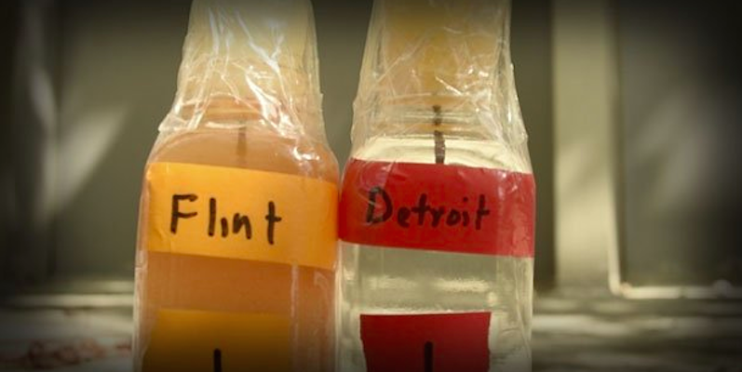
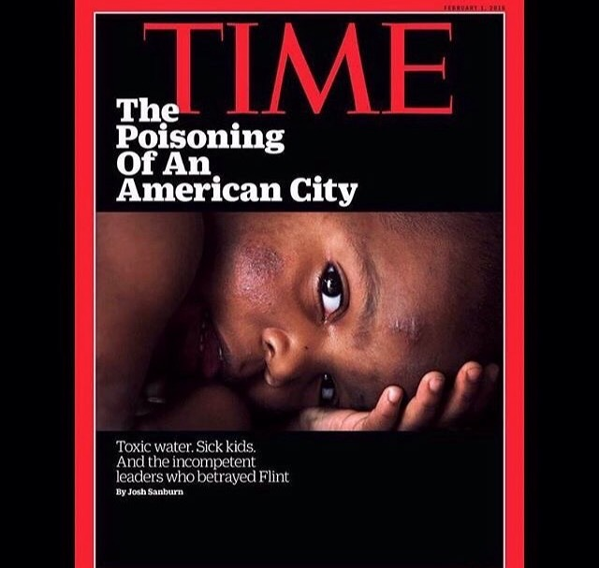
Flint Michigan Case

Slide 24
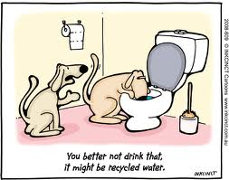
Water Recycling (the future?)
Or the present?
What is the difference between the hydrological cycle and water recycling?

Slide 25
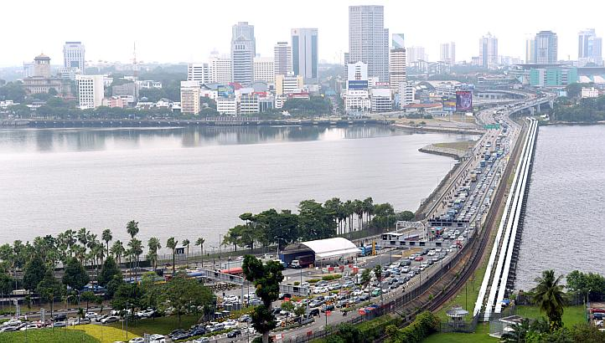
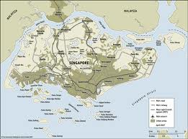
Singapore Case Study
5 Million people (700 kms²)
Very densely populated with extremely scarce water resources.
While a great deal of precipitation in region (2,300 mm/year), nowhere to store water reserves.
Testy relationship with Malaysia, particularly over water.

Slide 26
Scarcity-Induced Conflict?
“After Singapore’s expulsion from the Malaysian Federation, Johor offered to continue honoring the water contract. But relations between the island country and mainland remained guarded. For Singapore, there was the possibility that Malaysia could use threats of cutting off the water supply as a way to apply political and economic pressure” (Rogers and Leal 2010: 34).
“The treatment method Singapore used, almost identical to that used by Orange County, includes the three-step process of microfiltration, reverse osmosis, and ultraviolet technologies… the water produced met the drinking standards of the US EPA and WHO” (Rogers and Leal 2010: 35).

Slide 27

NEWater
Have embraced water recycling (NEWater).
By 2011 approximately 30% of Singapore’s water needs met by NEWater.

Slide 28

Australia Case Study
There is a great deal of (somewhat hidden) debate over water recycling in Australia.
Much of it focuses on informing the public about the hydrological cycle.

Slide 29
SUMMARY & CONCLUSION

Slide 30
Key point 1
Hydrological processes
Runoff, infiltration, erosion, sediment transport, saline intrusion, groundwater
IWRM
Water Scarcity
Does production, entitlement, commission/omission help us understand the cases?
Is scarcity being used in ways that benefit some at the expense of others?
What does knowing this mean for controversies like water recycling?

Slide 31
Next Class
Guest Lecture from Dr. Chris Walsh
The Melbourne de-sal controversy.

Slide 32
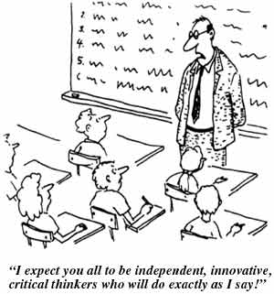
Questions or Concerns
Questions?

Slide 33
Sources & Further Reading
Allan, J. A. 2011. Virtual Water: tackling the threat to our planet's most precious resource. London, I.B.Tauris.
Amery, H. A. and Wolf, A. T. 2000. Water in the Middle East: a geography of peace, University of Texas Press Austin.
Brock, L., Homer-Dixon, T., Perelet, R., Vlachos, E. and Gleditsch, N. 1997. Conflict and the Environment, Springer.
Chapagain, A. K. and Hoekstra, A. Y. 2008. The global component of freshwater demand and supply: an assessment of virtual water flows between nations as a result of trade in agricultural and industrial products. Water International 33(1): 19-32.
Chellaney, B. 2011. Water: Asia's New Battleground. Washington D.C., Georgetown University Press.
Gleick, P. H. 1993. WATER AND CONFLICT - FRESH-WATER RESOURCES AND INTERNATIONAL SECURITY. International Security 18(1): 79-112.
--- 1998. Water in crisis: Paths to sustainable water use. Ecological Applications 8(3): 571-579.
--- 2000. The changing water paradigm: A look at twenty-first century water resources development. Water International 25(1): 127-138.
--- 2002. Water management - Soft water paths. Nature 418(6896): 373-373.
Gleick, P. H. and Lane, J. 2005. Large international water meetings: Time for a reappraisal - A water forum contribution. Water International 30(3): 410-414.
Hoekstra, A. Y. and Hung, P. Q. 2005. Globalisation of water resources: international virtual water flows in relation to crop trade. Global Environmental Change-Human And Policy Dimensions 15(1): 45-56.
Homer-Dixon, T.F. (1994) Environmental scarcities and violent conflict: evidence from cases. International Security 19, 5-40.
Homer-Dixon, T.F. (2010) Environment, scarcity, and violence. Princeton University Press.
Ma, J., Hoekstra, A. Y., Wang, H., Chapagain, A. K. and Wang, D. 2006. Virtual versus real water transfers within China. Philosophical Transactions of the Royal Society B-Biological Sciences 361(1469): 835-842.
Mitchell, B. (2013) Resource & Environmental Management. Routledge.
Nonetheless, I. (2012) What Should Be Integrated?
Seekell, D. A., D'Odorico, P. and Pace, M. L. 2011. Virtual water transfers unlikely to redress inequality in global water use. Environmental Research Letters 6(2).
Wolf, A. T. 1998. Conflict and cooperation along international waterways. Water Policy 1(2): 251-265.
Wolf, A. T. 1999. "Water wars" and water reality: Conflict and cooperation along international waterways. Environmental Change, Adaptation, And Security 65: 251-265.

